Slide 1
Online időpontfoglaló fullstack webalkalmazás fejlesztése
Jankó Júlia
Konzulens: Kövesdán Gábor

Slide 2

Use case
List/Search providers
Manage profile
Book appointment
User
Manage appointments
Provider
Manage provided services

Slide 3
Some action flow diagram?

Slide 4



Architecture
React Frontend
Rest API
Spring Backend
JPA
SQL server

Slide 5
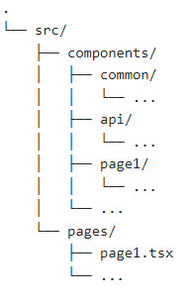
Initial frontend
TODO: Picture of frontend
Notes:
Tree source: https://tree.nathanfriend.io
MUI components!!!!

Slide 6
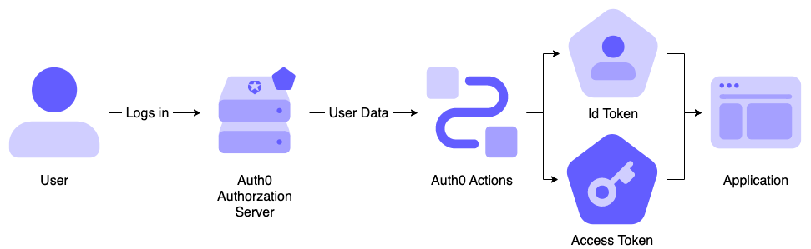
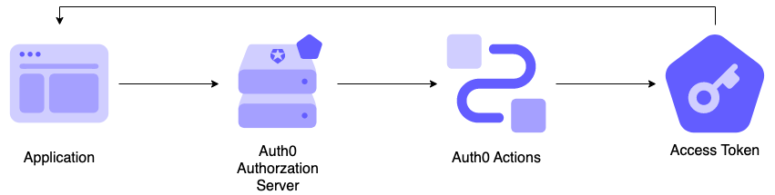
Authentication with Auth0
OpenID based authentication
Login flow
Machine to machine flow

Slide 7
Backend architecture

Slide 8
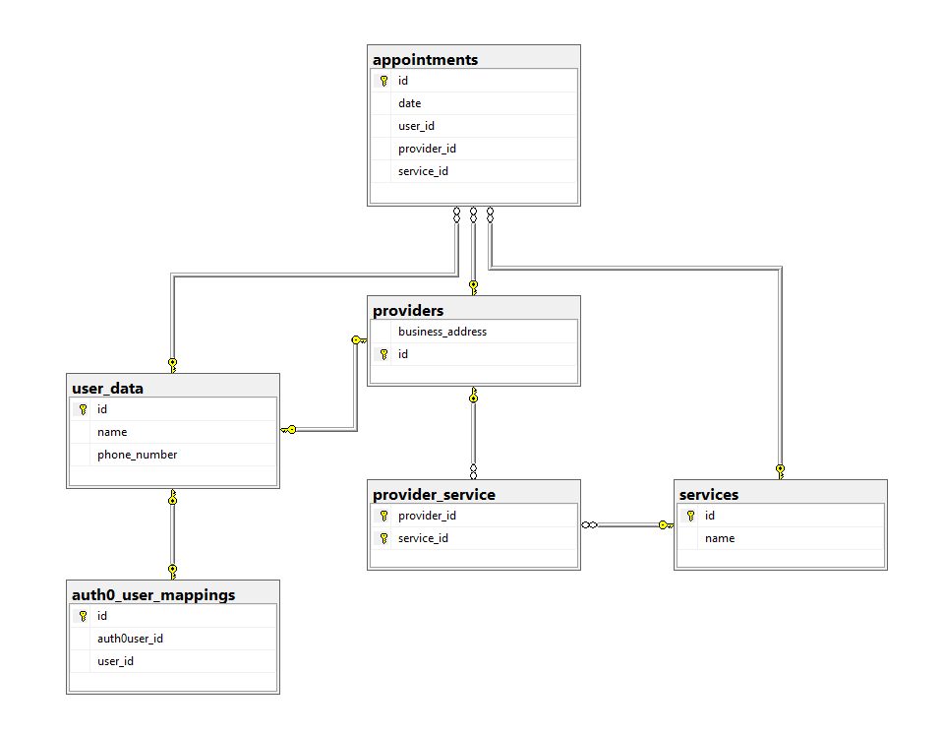
Data model

Slide 9


Future work
E2E pipeline
Authentication flow
Some feature implementation
Complete required features
UI refinement
Extra features

